Slide 1









MYSQL
PROJECT ON
WORLD WIDE ENERGY CONSUMPTION
ANALYSIS

Slide 2


INTRODUCTION
This project is an SQL-based analysis of worldwide energy consumption across different countries.
It uses real-world data on energy production, consumption, emissions, GDP, and population collected over multiple years.The data is stored in a relational database and analyzed using SQL to identify trends, comparisons, and relationships.The project helps understand how energy usage impacts economic growth and environmental sustainability.

Slide 3

PROBLEM STATEMENT
Global energy consumption is increasing due to population growth and economic development, leading to higher emissions and environmental concerns. Energy production, consumption, and emissions differ widely across countries based on GDP, population, and energy sources. Analyzing this data is essential to understand usage patterns, identify imbalances, and support better energy planning and sustainability decisions.

Slide 4
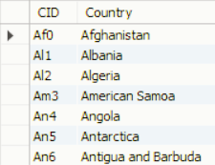
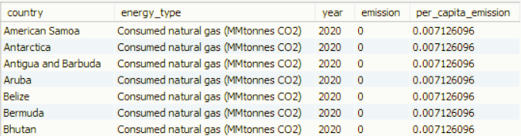

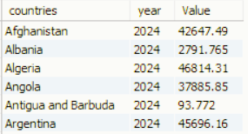
TABLES
COUNTRY
EMISSION_3
POPULATION

Slide 5
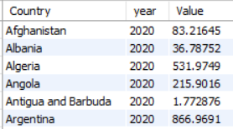
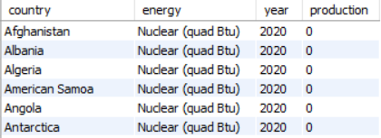
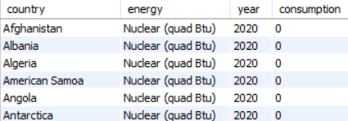
GDP_3
PRODUCTION
CONSUMPTION

Slide 6
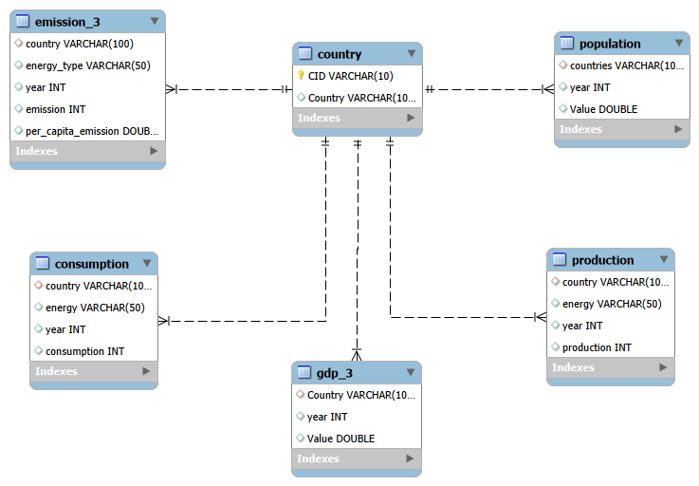
ER DIAGRAM

Slide 7
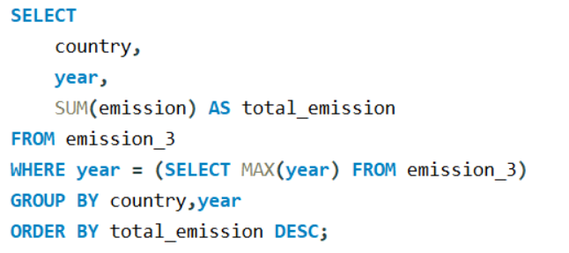
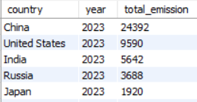

1.What is the total emission per country for the most recent year available?

Slide 8
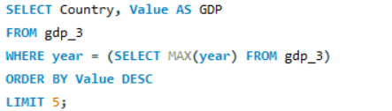
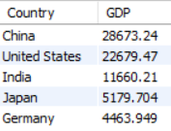

2.What are the top 5 countries by GDP in the most recent year?

Slide 9
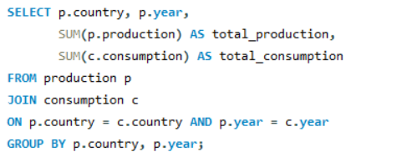

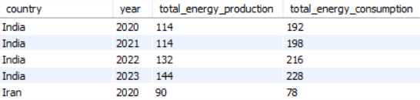
3.Compare energy production and consumption by country and year.

Slide 10
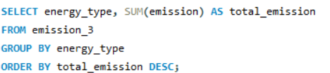
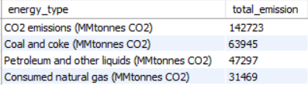

4.Which energy types contribute most to emissions across all countries?

Slide 11
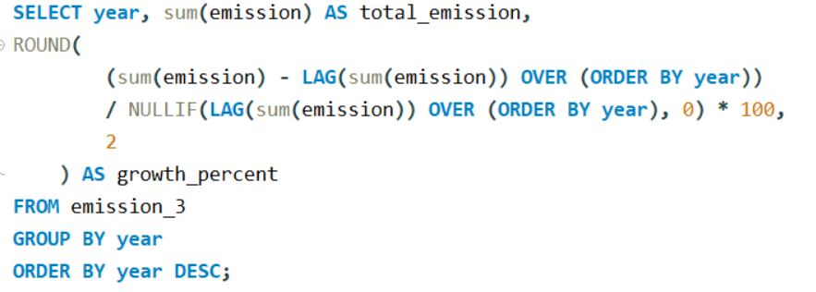

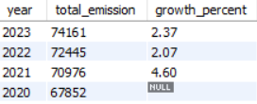
5.How have global emissions changed year over year?

Slide 12
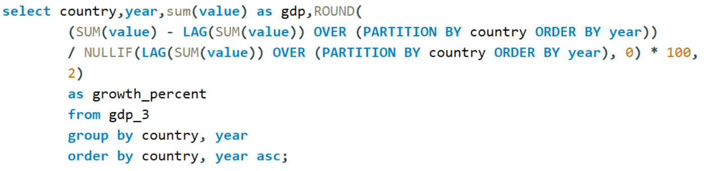
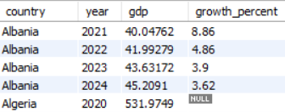

6.What is the trend in GDP for each country over the given years?

Slide 13
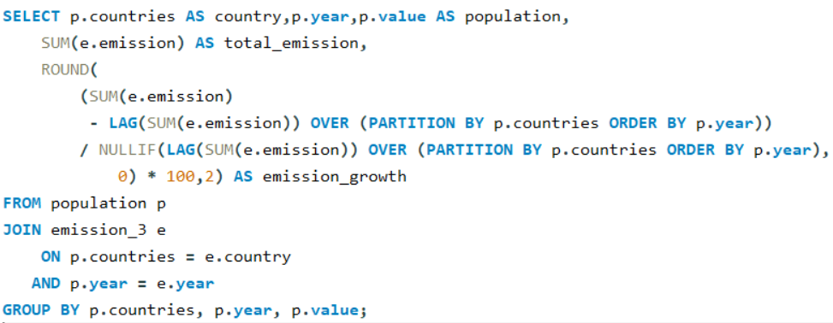

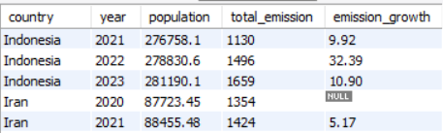
7.How has population growth affected total emissions in each country?

Slide 14
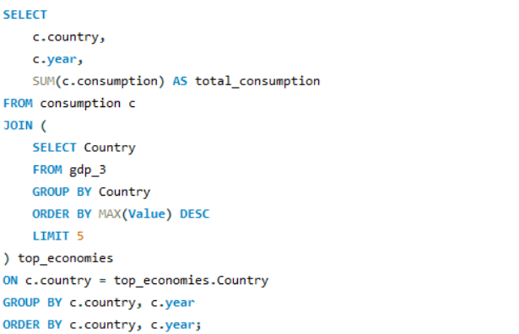
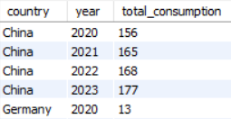

8.Has energy consumption increased or decreased over the years for major economies?

Slide 15
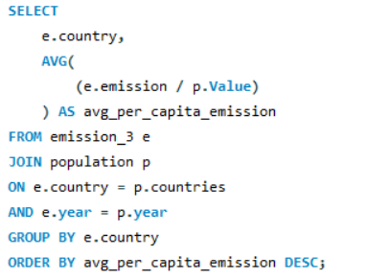
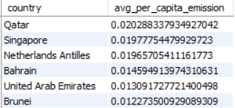

9.What is the average yearly change in emissions per capita for each country?

Slide 16
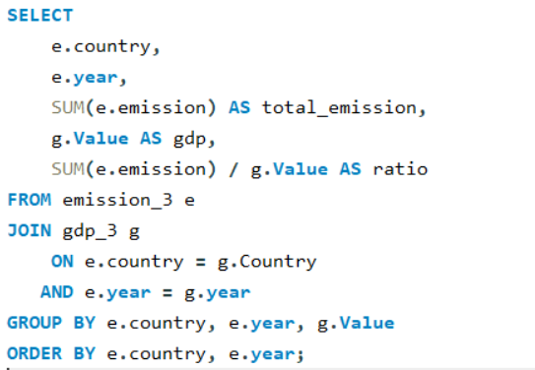
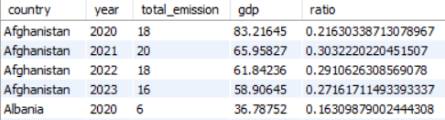
10.What is the emission-to-GDP ratio for each country by year?

Slide 17
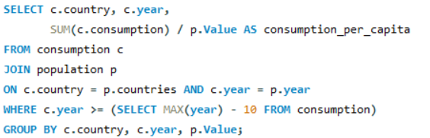
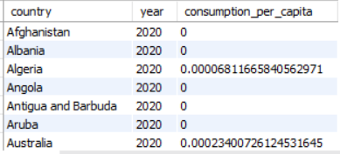
11.What is the energy consumption per capita for each country over the last decade?

Slide 18
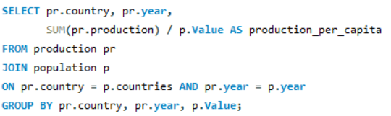
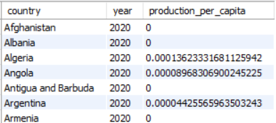
12.How does energy production per capita vary across countries?

Slide 19
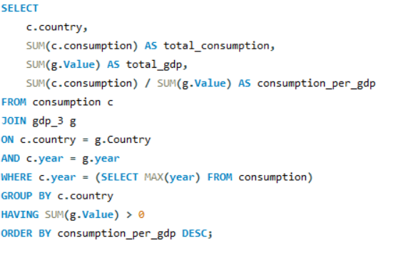
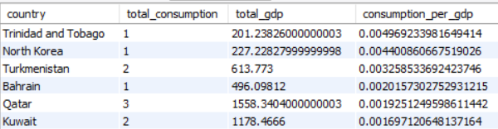

13.Which countries have the highest energy consumption relative to GDP?

Slide 20
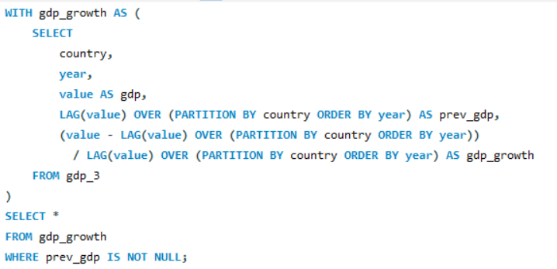
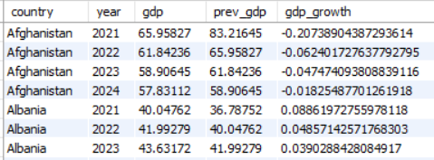
14.What is the correlation between GDP growth and energy production growth?

Slide 21
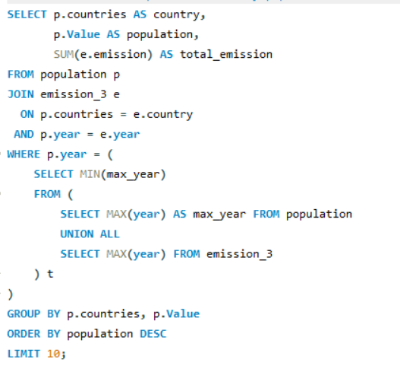
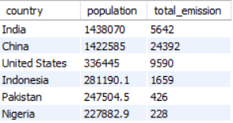

15.What are the top 10 countries by population and how do their emissions compare?

Slide 22
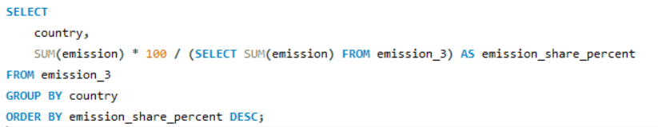
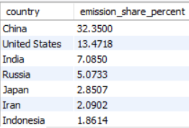
16.What is the global share (%) of emissions by country?

Slide 23
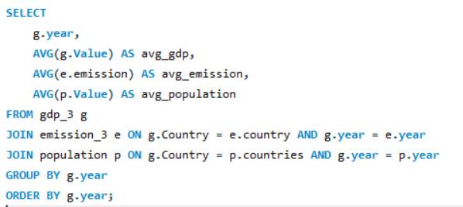
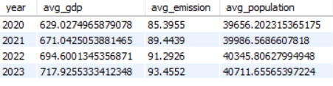
17.What is the global average GDP, emission, and population by year?

Slide 24

INSIGHTS
Energy consumption has increased steadily over the years for most countries, especially major economies.
Countries with higher GDP generally show higher energy consumption, indicating a strong link between economic growth and energy usage.
Emissions are higher in countries that rely heavily on fossil fuels for energy production.
Population growth contributes to higher total emissions, but per-capita emissions vary significantly across countries.
Some developed countries show stable or reduced per-capita emissions despite economic growth, indicating better energy efficiency.

Slide 25

CONCLUSION
This project successfully analyzed global energy consumption data using SQL to understand the relationship between energy usage, production, emissions, GDP, and population across countries and years. The analysis showed that economic growth is closely linked to increased energy consumption and emissions. Population growth further adds to the overall environmental impact, while per-capita trends highlight differences in energy efficiency among countries. By organizing large datasets into a relational database and applying SQL queries, meaningful insights were extracted to support data-driven decision-making.

Slide 26

TOOLS USED
MySQL
MySQL Workbench
Excel / CSV datasets
PowerPoint

Slide 27



THANK YOU
Group Members:
G Thrilokya
B Pranavi

